Slide 1




SmartMail
An integrated system for spam detection and email reply
Group Project Presentation
Ghanibhuti Gogoi. Yuhan Chen. Siqi Chen.

Slide 2



Objective
  Build a pipeline for
    Spam Email Detection
    Reply Generation if not Spam
  Perform experiments to compare Different Approaches
    Data Augmentation
    Zero-Shot vs Few Shot
    LoRA vs Full Fine-Tuning

Slide 3
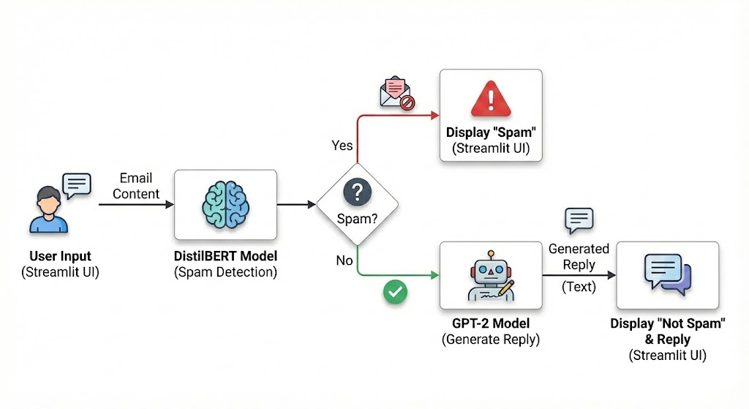
Core Pipeline
Contribution : Ghanibhuti Gogoi

Slide 4

Different Models Trained
Final Pipeline
(Streamlit UI)
Experiments
Data Augmentation
Classification (Distilled BERT)
Zero Shot vs. Few Shot vs. Fine-tuned
Reply Generation
(GPT2)
Lora vs. Full Fine-tuning
Contribution : Ghanibhuti Gogoi

Slide 5
Reply Generation
(DATASET)
Using neuralchat-7b model in ollama with
prompt = "Write a short, professional email reply to this message. Output ONLY the reply body. Do not include subject lines or place holders {Email}”
Non-spam emails from EnronSpam dataset
Synthetic Reply Dataset Generated
Contribution : Ghanibhuti Gogoi

Slide 6
Data Augmentation Strategies
We apply a simple and lightweight data augmentation:
  Synonym Replacement — replace up to n non-stopwords with WordNet synonyms
  Random Deletion — remove each word with probability p
  Random Combination — randomly choose synonym / deletion / both
Augmentation Modes:
  spam: augment only the Message field in enron_spam_data.csv
  reply: augment only the incoming Message (not the reply) for reply-generation dataset
Contribution : Siqi Chen

Slide 7
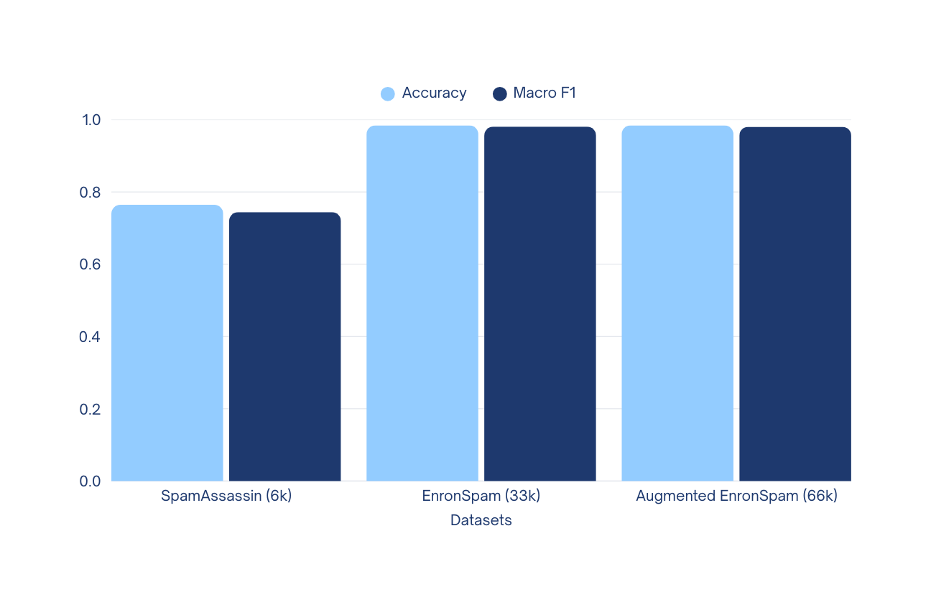
Data Augmentation Evaluation
spam classification
Contribution : Siqi Chen

Slide 8
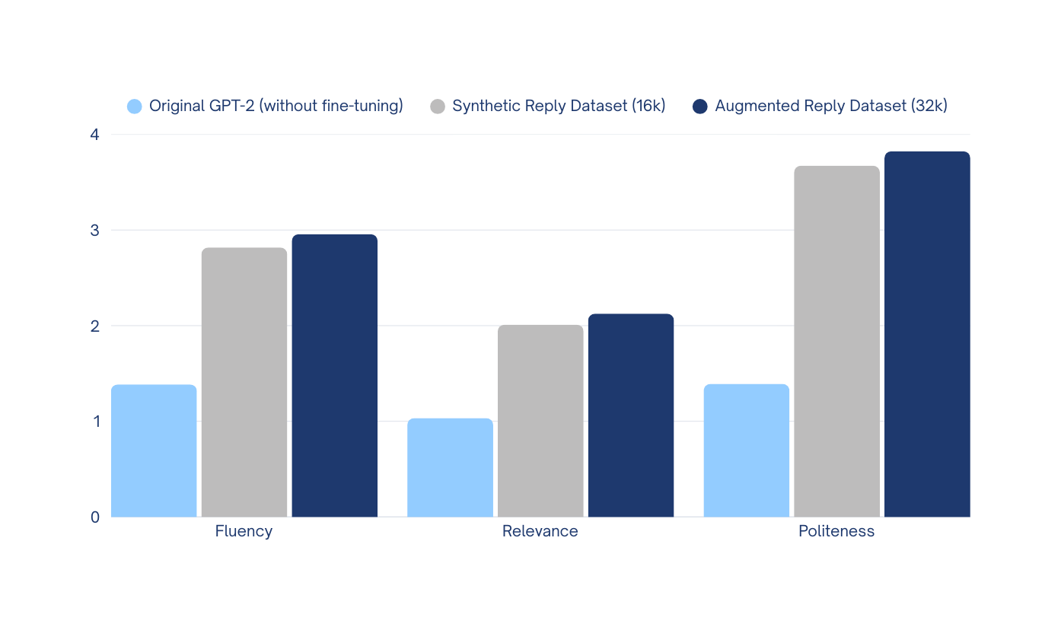
Data Augmentation Evaluation
reply generation
Contribution : Siqi Chen
Notes:
Training data size has a significant impact on model performance.
Models fine-tuned on a dataset of tens of thousands of samples consistently outperformed those trained on the original 6k-sample dataset, demonstrating that larger datasets enable the model to learn more robust representations and generalize better.
The data augmentation experiments did not yield noticeable improvements.
This is likely because the augmented dataset was already on the order of 10⁴–10⁵, providing sufficient coverage of linguistic patterns. Combined with the fact that the baseline performance was already strong, the additional synthetic data produced only marginal or negligible gains.

Slide 9
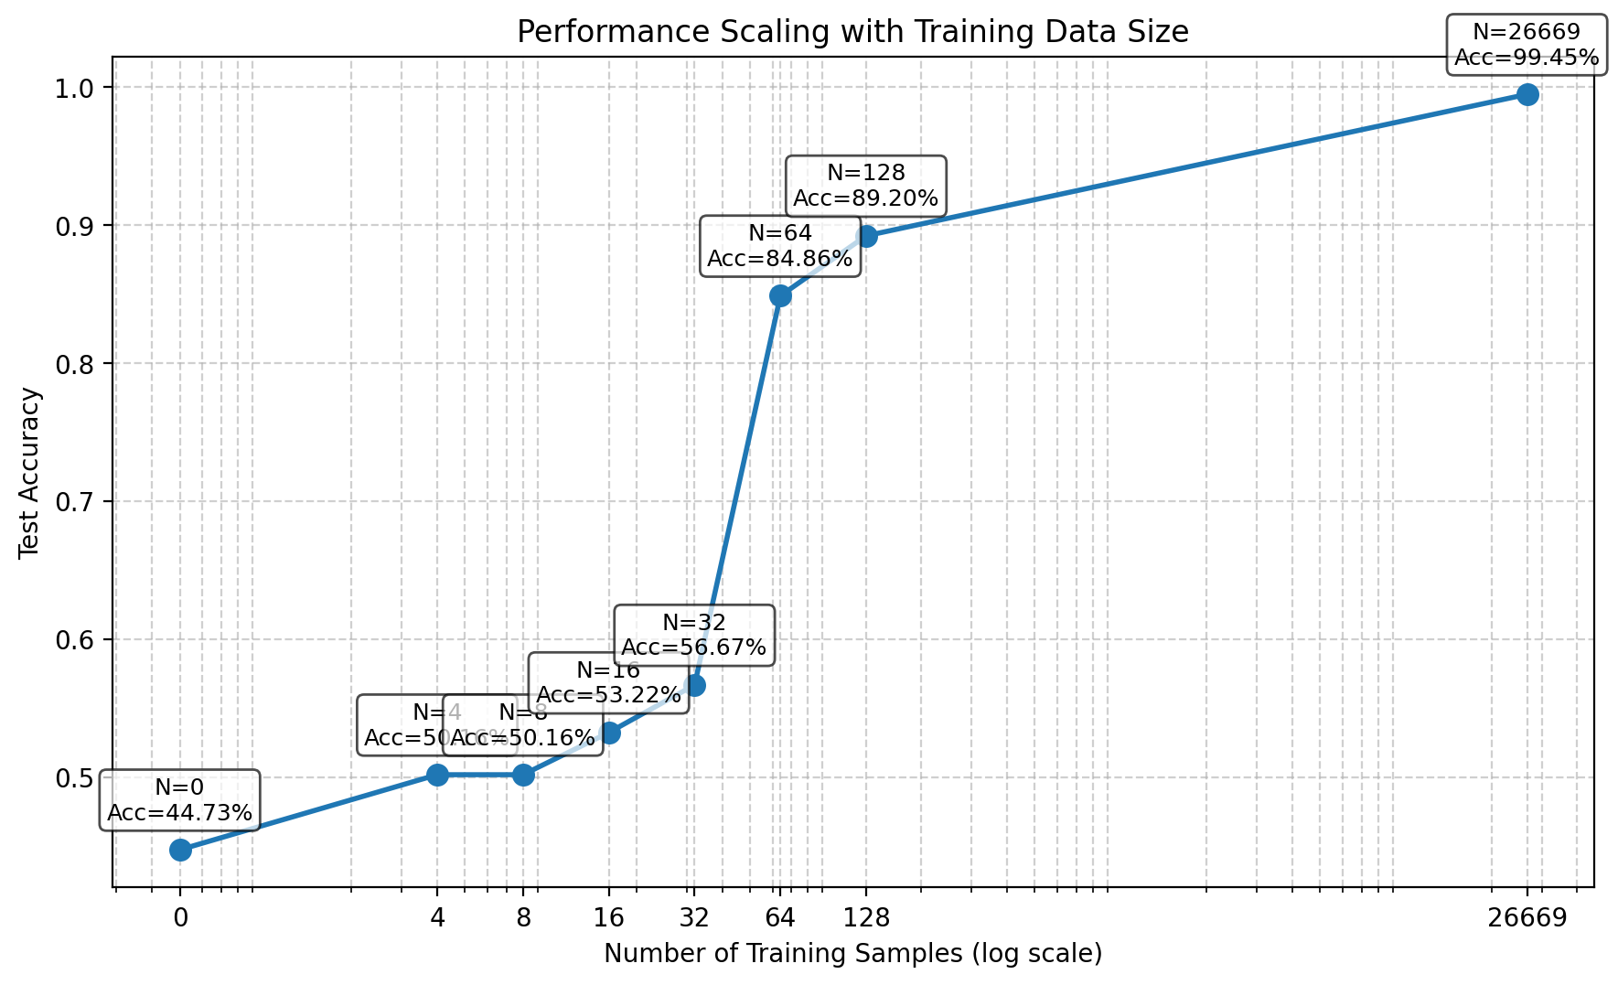
Few shot/Few-shot/Fine-tuned experiment
For Classification Model (Fix seed for sampling)
The size of our whole training set
Zero-shot
Few-shot
Fine-tuned
* Scaling experiments
Contribution : Yuhan Chen

Slide 10
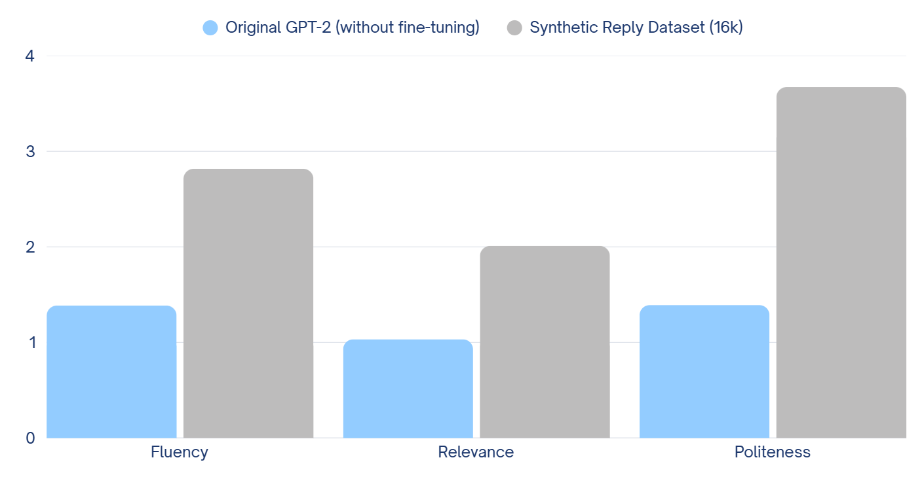
Zero-shot/Fine-tuned experiment
For Generation Model
Contribution : Yuhan Chen

Slide 11
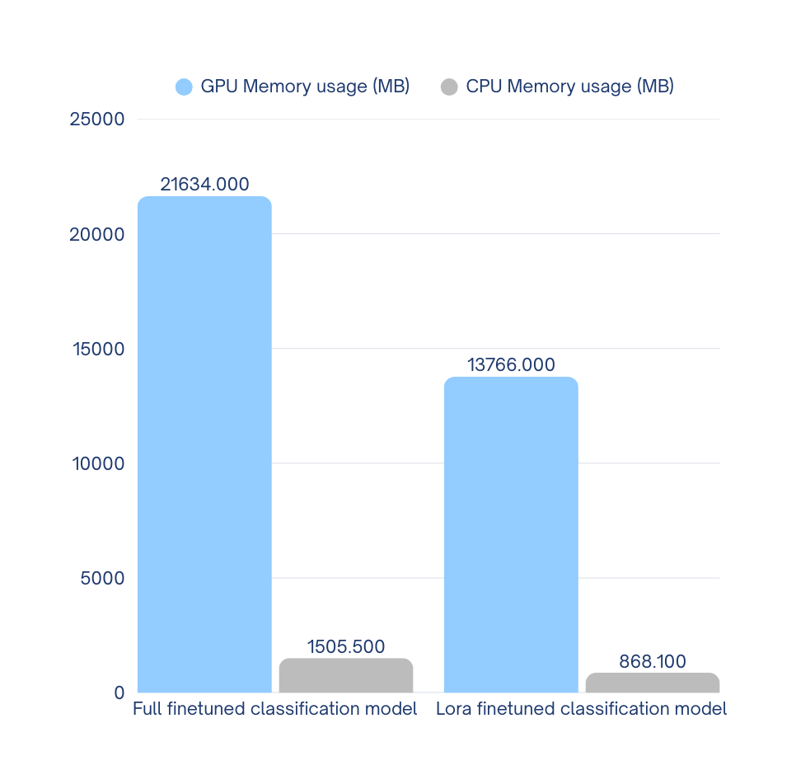
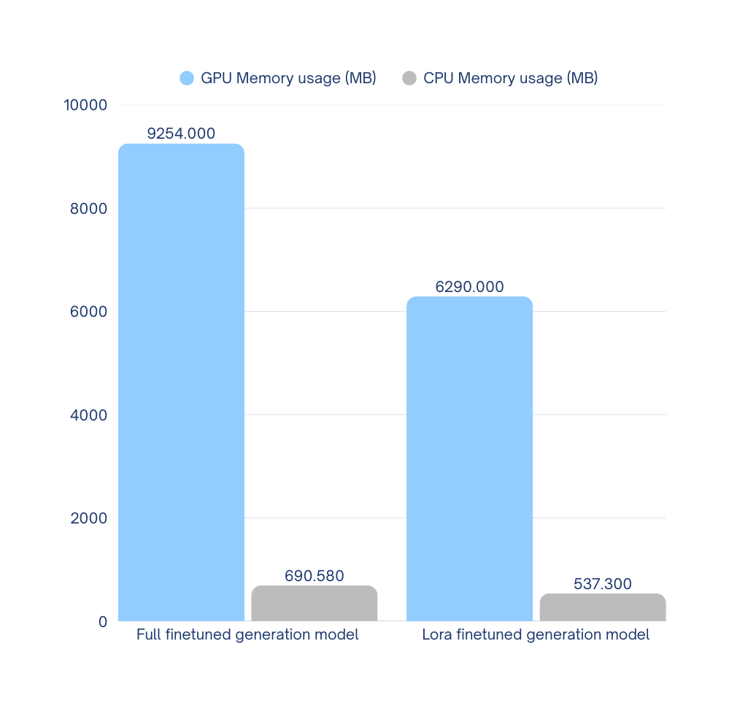

Lora/ Full-precision fine-tuning
Contribution : Yuhan Chen
Memory usage
* Hardware status:
GPU: T4 x 2 (15360MB x2)
  The way we calculate total GPU Memory usage is to sum the memory usage on each GPU.
32%
36%
42%
22%

Slide 12
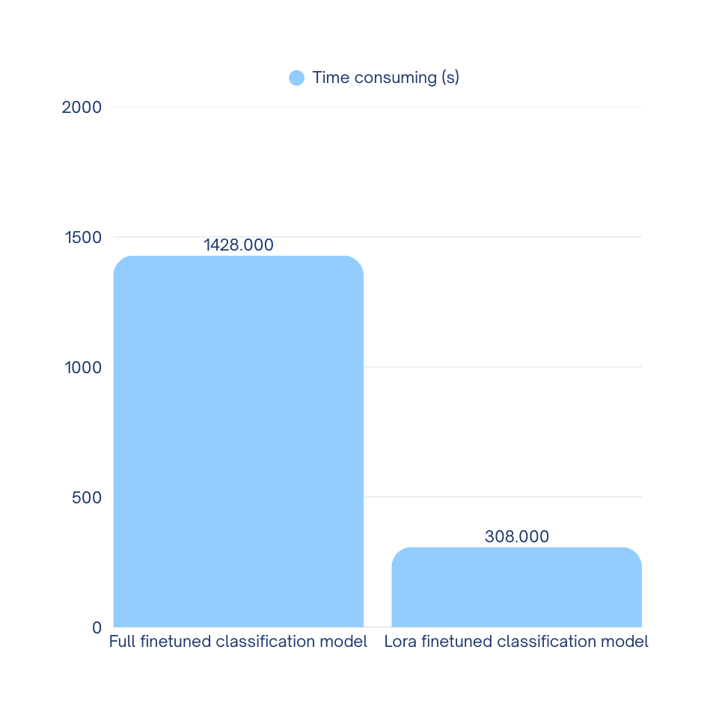
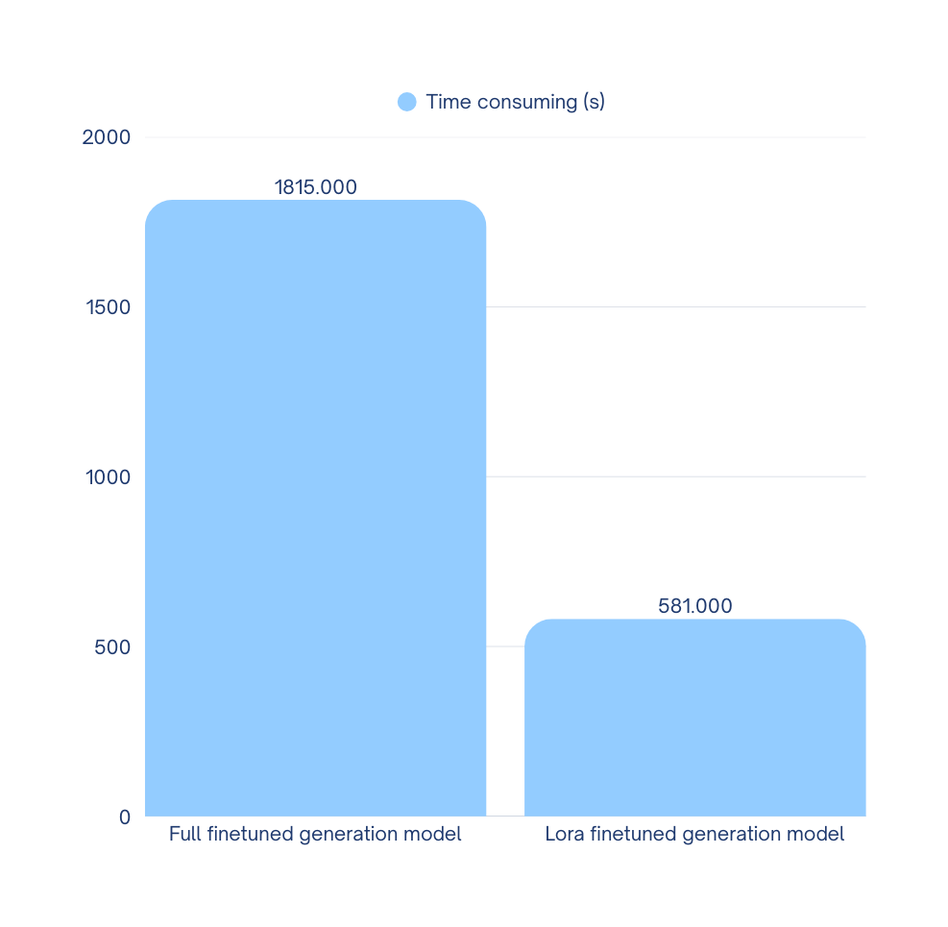
Lora/ Full-precision fine-tuning
Time consuming
Contribution : Yuhan Chen
  Here we only counting the time for training (exclude the time for data loading etc.)
68%
78%

Slide 13

Question & Answer Time and LIVE DEMO
Contribution : Ghanibhuti Gogoi

Slide 14
Thank You

